Slide 1
Sentiment Analysis Research
Barry Haworth
Ilana Lichtenstein
James Zhang

Slide 2
Intro to Sentiment Analysis

Slide 3
Two Data Sources
Twitter
Khoros Social Media Data
(ATO Social Media Unit)

Slide 4
Sentiment Analysis Work in Twitter (Barry)
Source of data
The Twitter API
Downloading Tweets
Analysing Tweets
Hashtags
Sentiment
Some limitations

Slide 5

Twitter
a microblogging and social networking service on which users post and interact with messages known as "tweets".
Short messages of 280 characters (originally 140) which can be labelled with #hashtags.

Slide 6
The Twitter API
Twitter have an Application Programming Interface (API)
Allows commands to read, post tweets.
Apply online

Slide 7
Downloading Tweets
Used Twitter API to download tweets with hashtag #ATO.
Ran from home computer, downloading tweets daily.

Slide 8
Issues with data
Tweets can be up to 280 characters. API only returns 140.
#ATO is applied to the Australian Taxation Office, but also Ankara Ticaret Odasi (Chamber of Commerce located in Ankara, Turkey.)
Notes:
Known issues with the data.

Slide 9
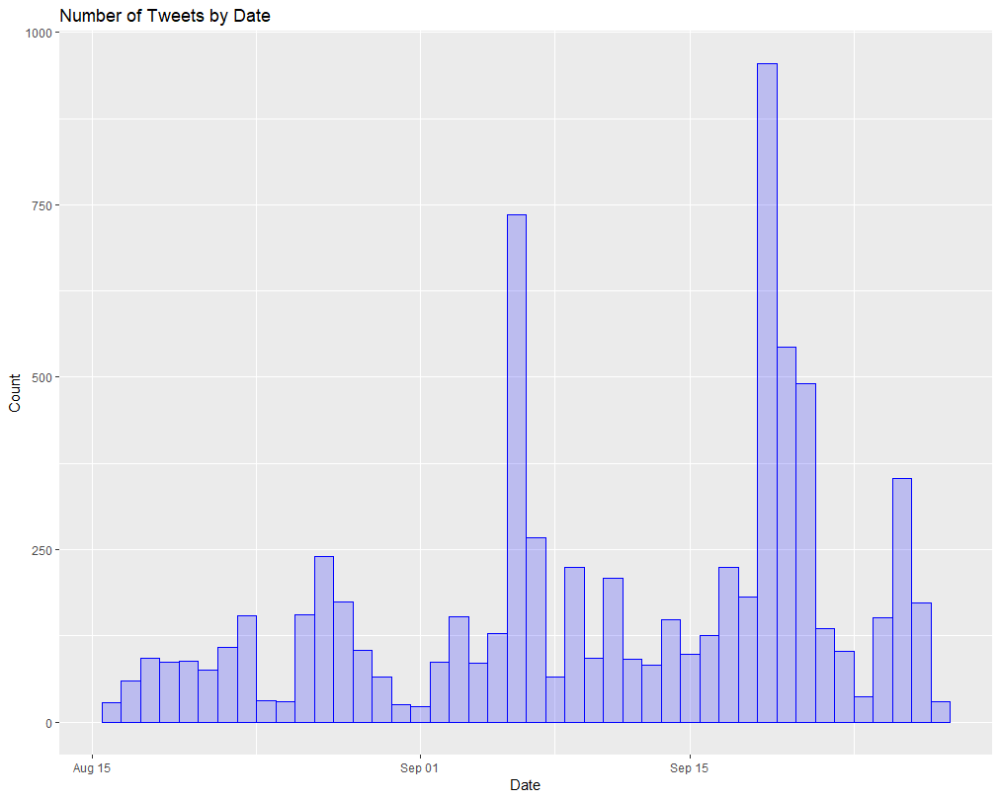
Analysis – Number of tweets
Total number of ATO tweets
Notes:
Number of #ATO tweets is not large as hashtags go.
Need to insert plot – histogram over time.

Slide 10
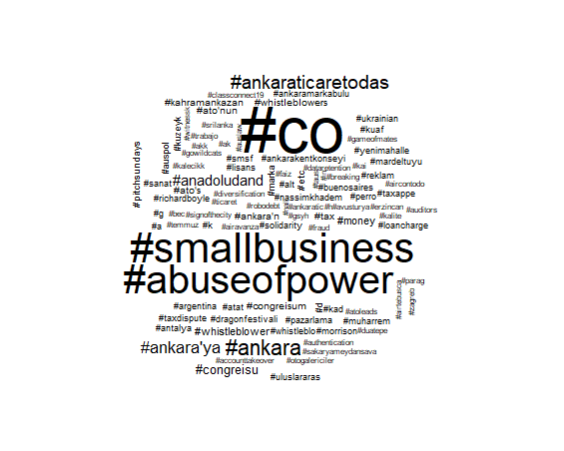
Analysis - Hashtags
Notes:
List of most common hashtags
Wordcloud of most common hashtags

Slide 11
Sentiment Analysis
Many different lists available. Used:
library(syuzhet)
Sentiment <- get_nrc_sentiment(ATO_tweets$text)
This gave counts of number of negative & positive words.
Did not review other lists.
Notes:
There are a lot of different options for sentiment analysis. I did not attempt to review alternatives, but took the first one I came across.

Slide 12
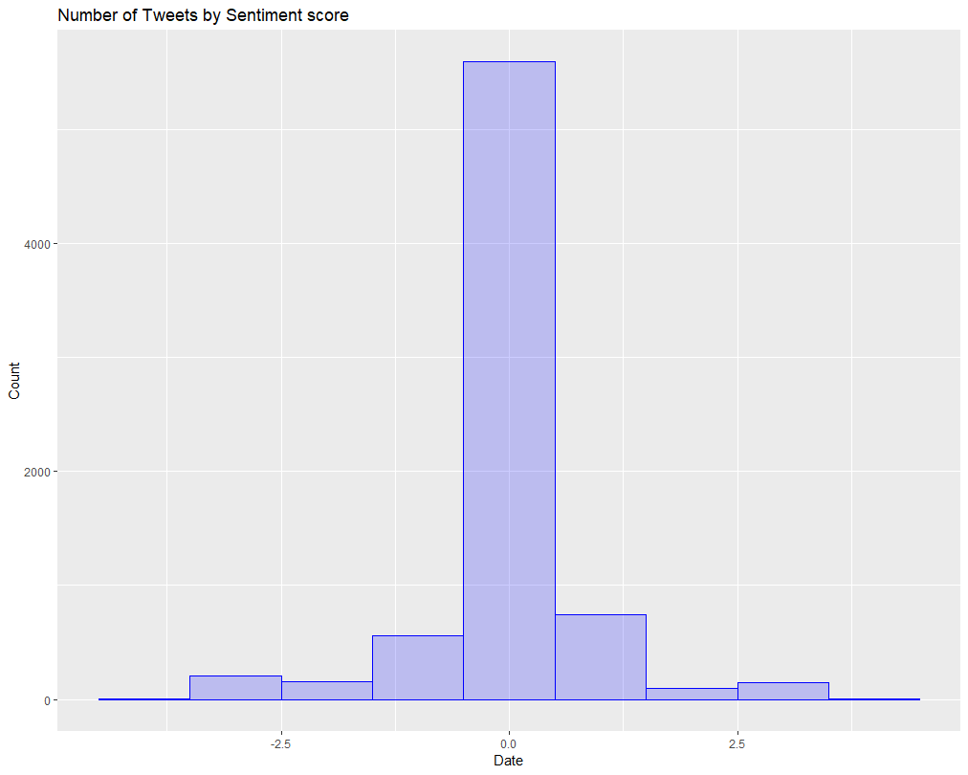
Number of Tweets by Sentiment
Notes:
Plot of ATO Sentiment over time
Table of ATO average sentiment, average sentiment by hashtag.

Slide 13
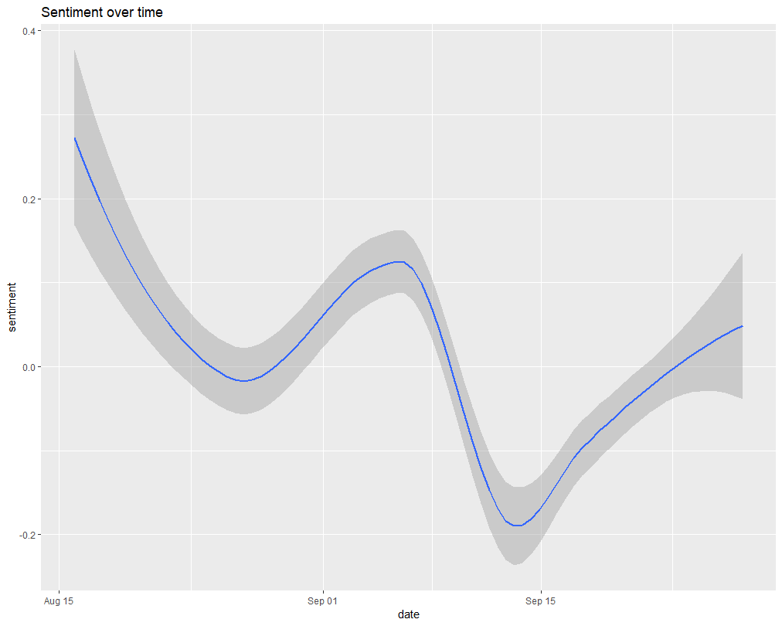
Sentiment over time
Notes:
Plot of ATO Sentiment over time
Table of ATO average sentiment, average sentiment by hashtag.

Slide 14
Sentiment by Hashtag
Notes:
Plot of ATO Sentiment over time
Table of ATO average sentiment, average sentiment by hashtag.

Slide 15
A comparison of open source sentiment analysis libraries (James)

Slide 16
An experiment with Rasa chatbot tool for “intent” prediction using Khoros data (Ilana present his work )

Slide 17
Conclusions and Findings (Ilana)

Slide 18
References
Git Repository: http://gitlab.radlab.local/MAD/sentiment-analysis-research

